Slide 1




Training Offer 2025 – 2026
“Empowering agencies, protecting communities:
Learning that safeguards every child”

Slide 2
Our Mission
Our training offer provides high-quality, multi-agency safeguarding learning opportunities designed to strengthen practice and improve outcomes for children, young people and adults at risk. Through a comprehensive programme of courses, workshops and resources, we aim to equip professionals with the knowledge, skills and confidence to identify, respond to and prevent harm effectively. The training is aligned with statutory guidance and local priorities, ensuring that all agencies work collaboratively to uphold the highest standards of safeguarding across Telford and Wrekin.

Slide 3
Menu
Training
Learning from SARs
Learning from DHRs
Learning from CSPRs
7-minute briefings
Toolkits & Best Practice Guidance

Slide 4
See what's available per month
January 2026
February 2026
March 2026
April 2026
May 2026
June 2026
July 2026
August 2026
September 2026
October 2026
November 2026
December 2026

Slide 5
Training Brochure

Slide 6
Back to Basics Training
The Back-to-Basics training is designed to strengthen good practice across the child protection system, guiding professionals through the safeguarding pathway from referral to child protection conferences and planning. Its aim is to improve outcomes for children and families by building confidence, clarity of roles, and professional curiosity in multi-agency practice.
How to book: Scan QR code to access Eventbrite

Slide 7
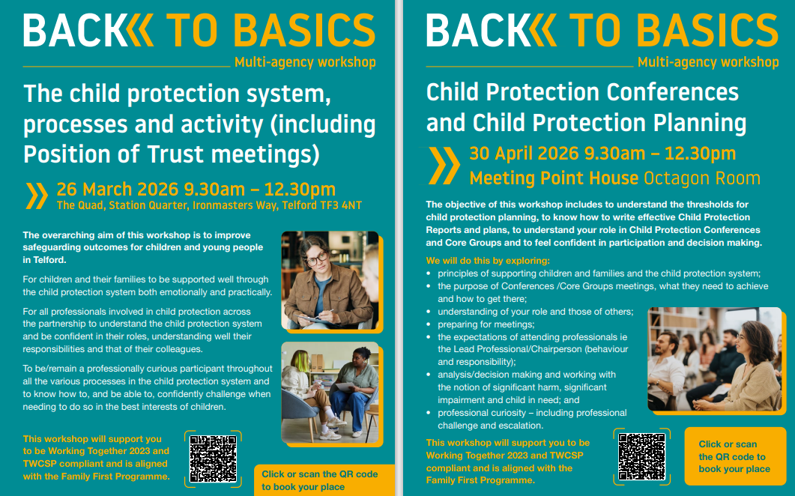

Slide 8
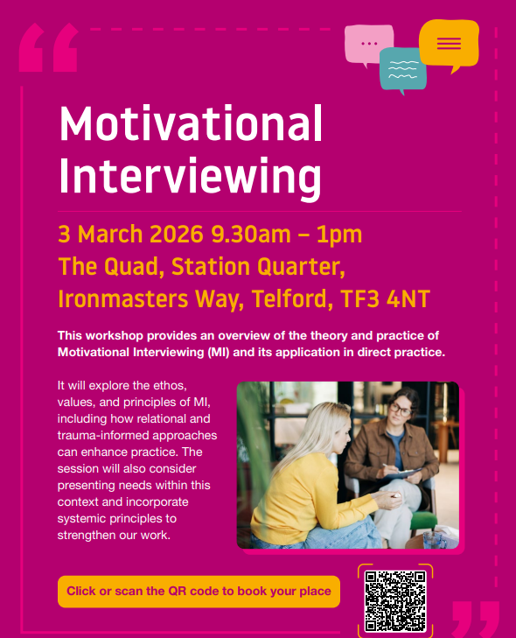


Slide 9

TWSP Threshold Guidance including Early Help Assessment and Support Plan briefing
Date | Time
Meeting Point House, Telford
5th February 2026 | 10:00-13:00
11th May 2026 | 10:00-13:00
18th September 2026 | 10:00-13:00
3rd December 2026 | 10:00-13:00
Follow the link to book:
TWSP Threshold Guidance including Early Help Assessment and Support Plan briefing : TWSP Threshold Guidance including Early Help Assessment and Support Plan briefing
This training provides an overview of Telford & Wrekin Safeguarding Partnership (TWSP) Threshold Guidance, explaining how to identify levels of need and risk and how to use the Early Help Assessment and Support Plan to coordinate timely, appropriate support for children and families.

Slide 10

Managing Allegations LADO
Date | Time
Meeting Point House, Telford
2nd March 2026 | 09:00-13:00
1st June 2026 | 14:00-17:00
7th September 2026 | 14:00-17:00
7th December 2026 | 09:00-13:00
Follow the link to book:
Course: Managing Allegations (LADO)
This training covers how to manage and respond to allegations against individuals working with children, following statutory guidance and the Local Authority Designated Officer (LADO) process to ensure safe, fair and consistent handling of concerns.

Slide 11

Raising Awareness of Private Fostering
Date | Time
Microsoft Teams
9th January 2026 | 12:00-13:00
18th March 2026 | 10:00-11:00
14th May 2026 | 15:00-16:00
10th July 2026 | 12:00-13:00
16th September 2026 | 17:00-18:00
6th November 2026 | 09:30-10:30
Follow the link to book:
TWSP Raising Awareness of Private Fostering Briefing
The Telford and Wrekin Safeguarding Partnership(TWSP) Raising Awareness of Private Fostering training provides a brief overview of what private fostering is, the legal requirements for notification, and the responsibilities of professionals in identifying and reporting private fostering arrangements to safeguard children.

Slide 12

Raising Awareness of Exploitation and Vulnerability
Date | Time
Microsoft Teams
22nd January 2026 | 09:00-11:00
21st April 2026 | 10:00-12:00
6th July 2026 | 12:00-14:00
1st October 2026 | 11:00-13:00
15th December 2026 | 10:00-12:00
Follow the link to book:
TWSP Raising Awareness of Exploitation and Vulnerability
The Raising Awareness of Exploitation and Vulnerability training helps professionals understand different forms of exploitation, recognise indicators of vulnerability and learn how to respond effectively to protect children and young people.

Slide 13
Brook Traffic Light Tool
Date | Time | Time
Meeting Point House
20th January 2026 |  | 09:00-13:00
Microsoft Teams
3rd March 2026 |  | 18:00-20:00
17th March 2026 |  | 18:00-20:00
(Both online sessions must be attended)
Follow the link to book:
TWSP - Brook Traffic Light Tool
The TWSP Brook Traffic Light Tool training teaches professionals how to use the Brook Traffic Light System to identify, assess and respond appropriately to sexual behaviours in children and young people, distinguishing between healthy, concerning and harmful behaviours.

Slide 14

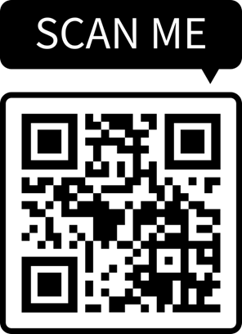
TWSP Understanding the role of the SARC
Date | Time
Face to Face (Southwater One)
18th May 2026 | 1pm-2.30pm
16th July | 10.30am-12pm
Online (Microsoft Teams)
15th July | 10am-11am
18th September | 9am-10am
To book a place follow link:
https://www.eventbrite.com/cc/twsp-understanding-the-role-of-the-sarc-4824272?just_published=true
Join us for essential training sessions delivered by a specialist practitioner from the SARC, designed to strengthen professional understanding of sexual assault support, referral pathways, and best practice when working with adults and young people.
Delivered by Martyne Roberts

Slide 15

Raising Critical Consciousness and Strengthening Culturally aware practice with Children and Families
Date | Time
Microsoft Teams
30th January 2026 | 09:30-11:30
12th March 2026 | 09:30-11:30
Email to book:
Partnerships@telford.gov.uk
Aims:
1. Understand the problem
Recognise how culturally unaware practice and systemic bias impact
relationships, decision-making and outcomes in working with Children
and Families.
2. Raising consciousness
Increase awareness of personal and structural biases and practice
techniques to notice and interrupt these.
3. Strengthen practice
Apply evidence-based frameworks and tools to support culturally
curious and aware practice embedding anti oppressive practice in
everyday decision making.

Slide 16

Family First Programme
The Families First Partnership (FFP) Programme is a UK government guidance aimed at reforming children’s social care by creating a more joined-up, family-focused system of support.
The FFP Programme helps local safeguarding partners (like social care, health, and police) work together to deliver early, targeted support to families through:
Family Help services
Multi-agency child protection
Family Group Decision Making.
Its goal is to ensure families get the right help at the right time, keeping children safe and improving long-term outcomes.
National reviews have driven a commitment to reform, with Families First acting as the delivery programme to embed these changes locally. It aims to create a more responsive, relational, and preventative system—one that reflects the values of Telford & Wrekin’s Family First Approach.
The Government has published guidance about how the Families First Programme should be taken forward by Local Authorities including some minimum expectations.
As this programme rolls out there shall be further training offered across the Partnership which shall be advertised through the Telford and Wrekin Safeguarding Partnership.
Further reading: The Families First Partnership (FFP) Programme Guide

Slide 17

Kinship Local Offer Training
Date | Time
Microsoft Teams
18th December 2025 | 12:00-13:00
20th January 2026 | 16:00-17:00
18th February 2026 | 11:00-12:00
6th March 2026 | 13:00-14:00
Email to book:
Partnerships@telford.gov.uk
Do you work with children and families in Telford and Wrekin?
This online training session is designed to help professionals understand and support kinship families effectively.
Kinship care is when a child is raised by relatives or close family friends due to circumstances where their parents are unable to care for them. These families often face unique challenges and may not be aware of the support available to them.
This session will cover:
What kinship care is
The support available locally through the Kinship Local Offer
Key contacts and how to signpost families to the right services
You will also hear from a kinship carer (their journey and experiences)

Slide 18

Circle of Support
Date | Time
Quad (TBC)
Target audience: Duty Assessment/Cate/ Family Safeguarding/Family Hubs/Fostering (Education 20 delegates)
26th February 2026 | 09:00-16:00
27th February 2026 | 09:00-16:00
Email to book:
Partnerships@telford.gov.uk
The Circle of Support is a family-led decision-making process that brings together the child’s wider network of family, friends, and trusted individuals to create safe, sustainable plans for the child’s care and wellbeing. It empowers families to take the lead, strengthens relationships, and respects cultural identity and family values. The goal is to keep children within their communities and prevent unnecessary formal care arrangements by collaboratively finding practical solutions.
Training focuses on:
Understanding the principles and values of FGDM, including family empowerment and collaborative planning.
How to prepare and facilitate Circle of Support meetings effectively.
Skills for engaging families early, mapping support networks, and creating inclusive spaces.
Practical steps for developing plans that address safeguarding concerns and strengthen family resilience.
Cultural sensitivity and strategies for involving children and their advocates appropriately.

Slide 19

CSPR Lunch and Learn Sessions
Our CSPR Panel Lunch & Learn sessions offer a relaxed, accessible space for practitioners to explore emerging themes and key learning from local and national reviews. Each session is designed to strengthen shared understanding across the workforce, highlight patterns in practice, and support continuous improvement in how we safeguard children. By bringing colleagues together for focused, bitesize learning, we aim to promote reflective discussion, deepen professional curiosity, and translate insights into practical actions that enhance outcomes for children and families.

Slide 20

CSPR PANEL – Lunch & Learn
Having difficult conversations
Date | Time
Microsoft Teams
2nd June 2026 | 12:00-13:00
Book through Eventbrite: (Please note link to MS teams is within Eventbrite link)
Lunch & Learn: Having Difficult Conversations Tickets, Tuesday, Jun 2 from 12 pm to 1 pm GMT+1 | Eventbrite
These short lunch and learn sessions help practitioners develop confidence in managing sensitive or challenging conversations with children, families, and partners.
The focus is on clear, respectful communication, maintaining a child‑centred approach, and using professional curiosity to address concerns early and effectively.

Slide 21
CSPR PANEL – Lunch & Learn
Escalation Pathway
Date | Time
Microsoft Teams
21st July 2026 | 12:00-13:00
Follow Eventbrite Link to book: Please note to add manually to your calendar.
TWSP Lunch & Learn Escalation Pathway Tickets, Tuesday, Jul 21 from 12 pm to 1 pm GMT+1 | Eventbrite
These sessions give practitioners a clear, practical understanding of how to use the escalation policy and pathway when professional disagreements arise. The focus is on recognising when to escalate, communicating concerns constructively, and ensuring that the child’s safety and wellbeing remain central. By strengthening confidence in using the process, the sessions support effective multi‑agency working and timely decision‑making for children.

Slide 22


CSPR PANEL – Lunch & Learn
Escalation Pathway
Date
Microsoft Teams
12:00-13:30
7th July 2026 5th November 2026 1st February 2027
Follow Eventbrite Link to book: Please note to add manually to your calendar. Challenging Bias in Safeguarding DA Practice | Eventbrite
Recent Domestic Homicide Reviews (DHRs) have highlighted the critical role unconscious bias, myths and stereotypes can play in shaping professional decision-making. This training is being delivered directly in response to those learning points, to support safer, more informed practice.

Slide 23



Continuing Professional Education for Schools
Please follow the link to view Telford Education Services available training brochure
Notes:
Please put under tab Education Training Page

Slide 24

Strengthening multi-agency leadership in responding to intra-familial child sexual abuse
Workshop one: Strategic planning
Presented by: Dr Natasha Sabin and Jenny Coles
Date: 14th January 2026
Time: 13:00 to 14:30
Workshop two: Professional knowledge, skills and confidence
Presented by: Anna Glinski and Lorraine Myles
Date: 3rd February 2026
Time: 13:00 to 14:30
Workshop three: Enquiries and investigations
Presented by: Paul Burnside and Nick Connaughton
Date: 12th March 2026
Time: 10:00 to 11:30
Workshop four: Assessment of people presenting risk of sexual harm
Presented by: Anna Glinski, TJ Abrahams, and Becky Canning
Date: 21st May 2026
Time: 10:00 to 11:30
Workshop five: Talking to children
Presented by: Lorraine Myles and Dr Natasha Sabin
Date: 17th June 2026
Time: 10:00 to 11:30
Workshop six: Health
Presented by: Nici Evans and Dr Alison Steele
Date: 13th July 2025
Time: 13:00 to 14:30
To book: https://www.csacentre.org.uk/training-events/strengthening-multi-agency-leadership-webinar-series/

Slide 25
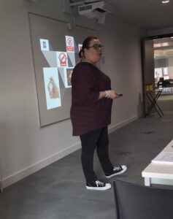

Introduction to sexual violence/abuse
Aim of the course
Identify a clear definition of “Sexual violence/abuse”.
Explain what the role of an ISVA is in relation to victims/survivors of sexual violence/abuse.
Be able to dispel some of the myths around sexual violence/abuse.
Identify the impact of sexual violence/abuse on the victim and their family.
Understand the definition of consent.
Identify the signs of sexual abuse.
Understand the importance of communicating and responding to concerns of sexual violence/abuse.
Be able to explain the does and don’ts when interacting with victims of
Our introductory course is a free 3-hour session, delivered face to face, we can come to your organisation, or you can book through joint training.
For more information on the above course, please do contact Dawn Shanahan on the following email address, or call the number below.
training@axiscounselling.org.uk

Slide 26
Open Access
Our open access training programme provides free, high-quality safeguarding learning opportunities for professionals and volunteers across Telford and Wrekin, drawing on expertise and resources from neighbouring partnerships to ensure a comprehensive and collaborative approach.

Slide 27
Open access learning links
Professional Curiosity Toolskit | SAB Network /TWSP
Listen Learn Lead | Make It Real
Who Cares for the Carers Seminar | T&W Council
Domestic Abuse | West Mercia
Neglect Webinar | West Midlands Regional
Predatory Marriage | Our Story
Adults at risk of harm due to fire | Walsall Saffeguarding
Pressure Ulcers | Telford Viability
Mental Capacity | Shropshire Council
Abuse and Exploitation | Telford & Shropshire Partnership
FGM | Virtual College
Home Office Prevent | Home Office
Understanding DBS | Telford and Wrekin
Trauma & the brain | West Midlands
The importance of robust recording | Safeguarding Association
Suicide Prevention Awareness | Papyrus
Online Safety Webinars for Schools | NSPCC
Mandatory Reporting Child Sexual Abuse | NSPCC
ACEs training £5 | Xerlerate
FGM Training | Home Office
Forced Marriage E Learning | Home Office
Identifying and Responding to intrafamilial child sexual abuse | CSA Centre

Slide 28
7 minutes briefings by Telford and Wrekin Safeguarding Partnership
Safeguarding Adults Reviews
Alcohol and Substance Misuse During Pregnancy
Professional Boundaries
Sarahs Law
Professional Curiosity
Care Planning Briefing
Roles & responsibilities
Supporting International Students
Information Sharing
Trauma Informed Practice

Slide 29
7 minutes briefings by Telford and Wrekin Safeguarding Partnership
Online Safety
Contextual Safeguarding
Domestic Abuse
Predatory Marriage
DHRs and Suspected Suicide
Self Neglect
Modern Day Slavery
Home Takeover

Slide 30
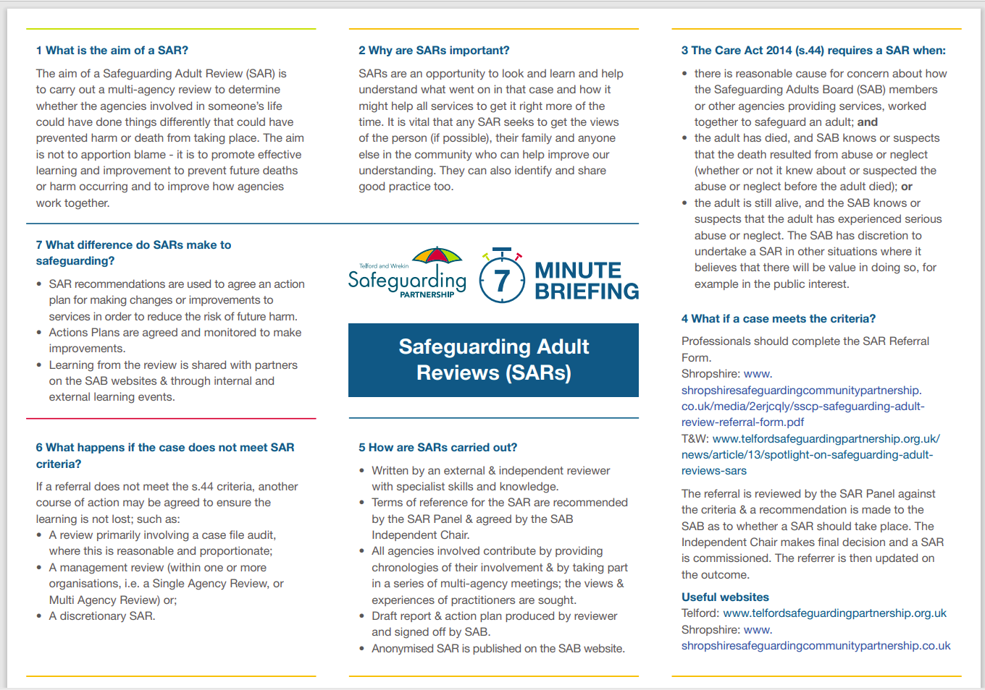

Slide 31
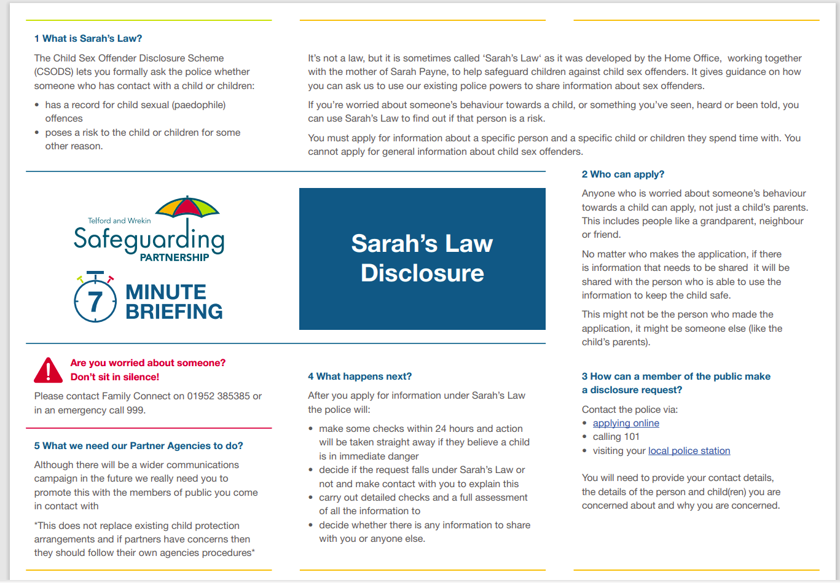

Slide 32
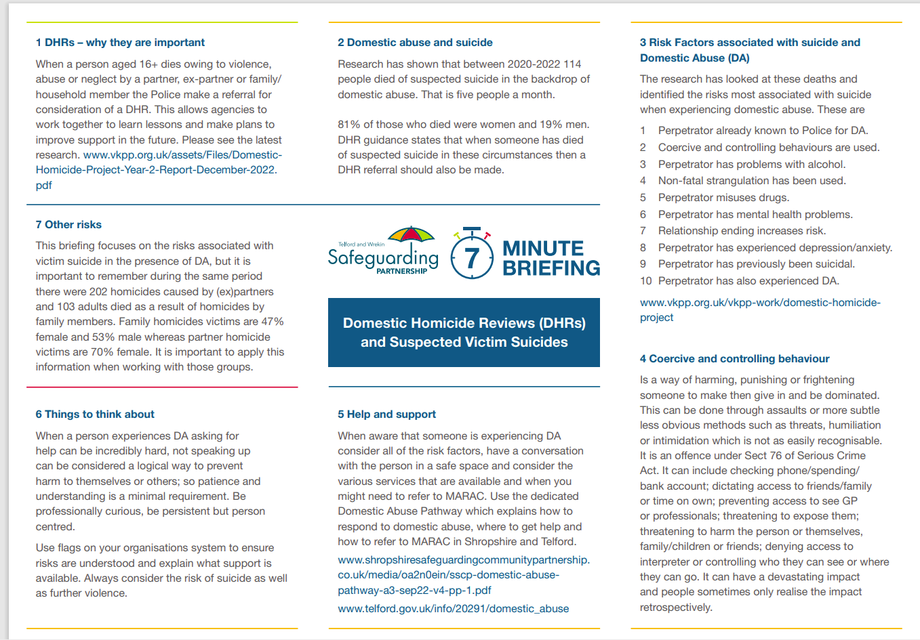

Slide 33
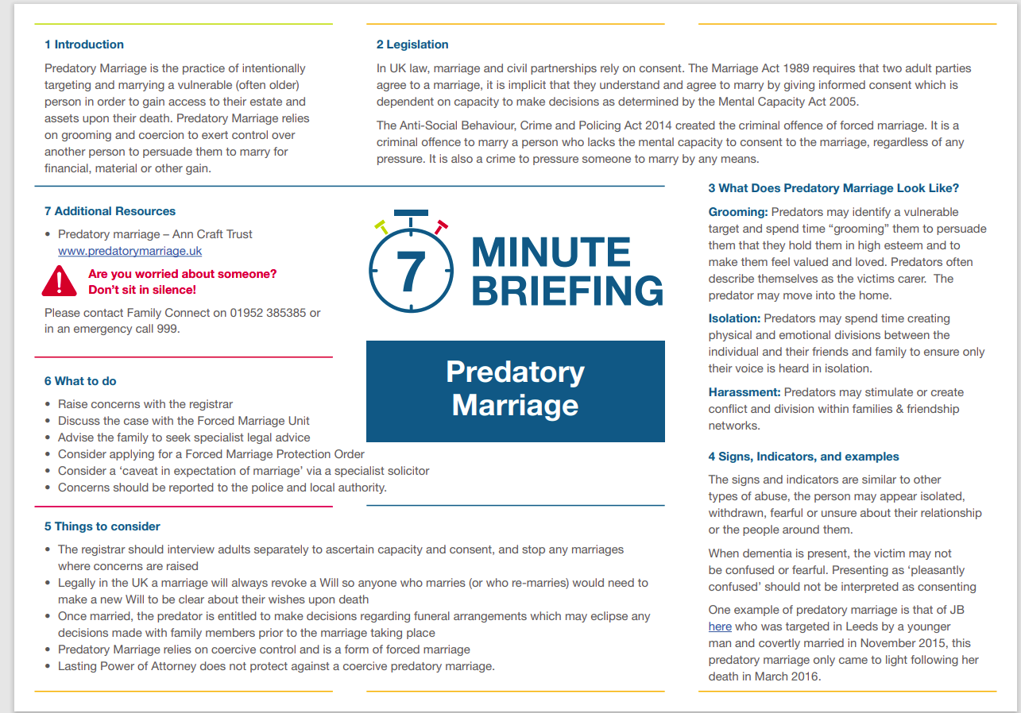

Slide 34
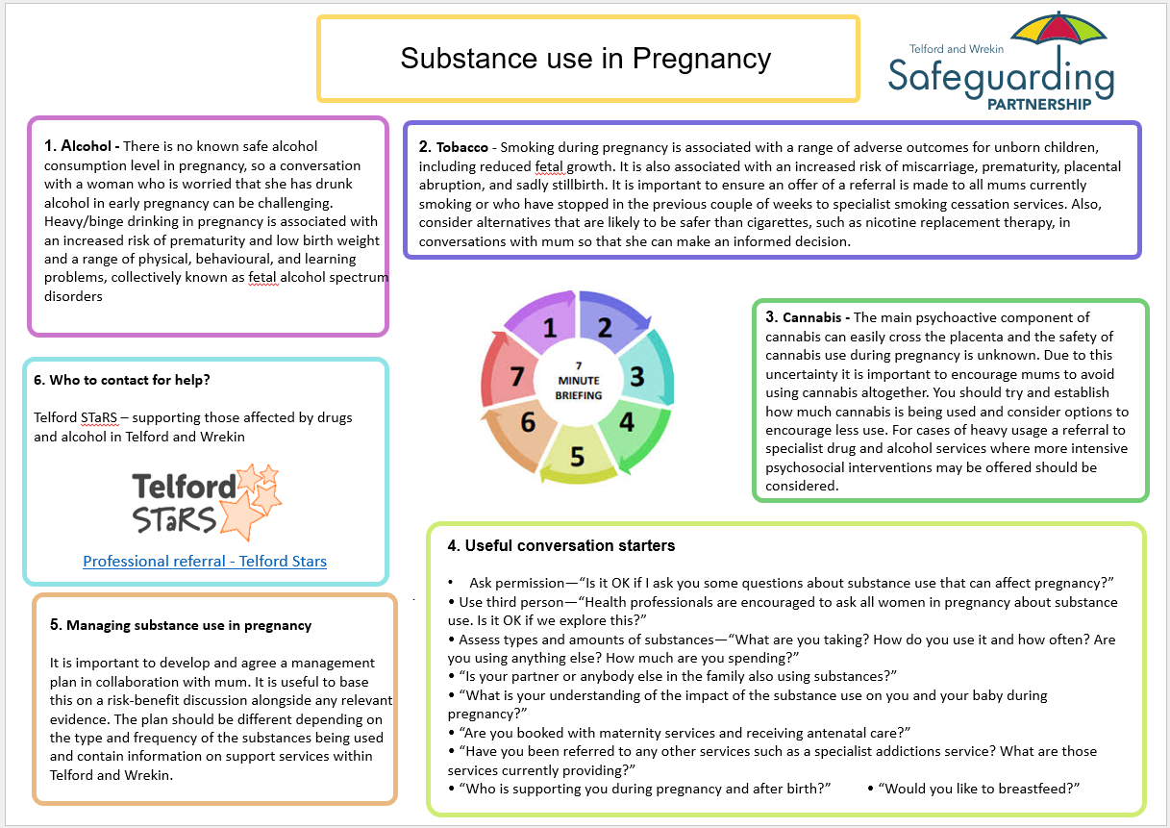

Slide 35
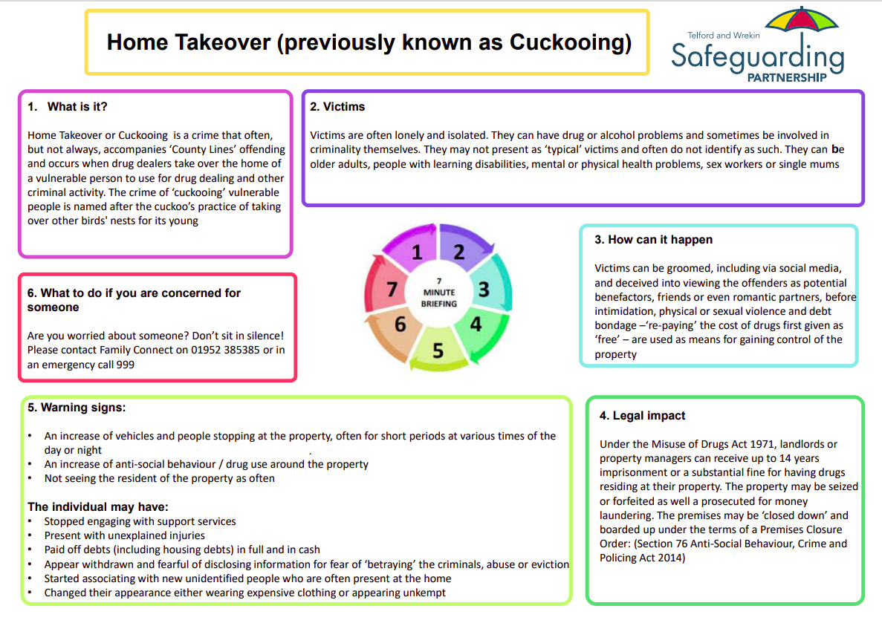

Slide 36

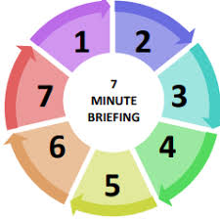
Professional Boundaries
Karen Littleford, Partners in Care
What are Professional Boundaries?
Boundaries are there to keep people safe. They are a set of guidelines, expectations and rules which set the ethical and technical standards in the social care environment and in related sectors. Professional boundaries set limits for safe, acceptable, and effective behaviour by workers (Cooper, 2012). They provide an outline of what is acceptable and unacceptable for a professional, whilst at work and outside of work.
2. Who Has Professional Boundaries?
Professional Boundaries apply to those who are working or volunteering in a role that could be described as being in a position of trust. This includes roles within social care, health, housing and other connected sectors including voluntary roles.
3. Why Do We Need Professional Boundaries?
Having professional boundaries ensures that the relationship between social care, health workers (and other workers or volunteers) and the children/adults they support remain professional, even when working with personal and difficult issues (Hardy, 2017). Upholding key boundaries not only protects workers, but also protects children/adults using specific services and the organisation (Hardy, 2017).
7. What To Do If You Are Concerned About Professional Boundaries?
Talk to your line manager if you are concerned about your own boundaries or those of someone else you work with
Ensure individuals using services, family members and others know how to raise concerns about boundaries with the service
4. Examples of Professional Boundaries Breaches (not exhaustive):
Confidentiality breaches
Sharing inappropriate information or photos of children/adults who use a service on social media
Inappropriate physical contact
Inappropriate language, or use of terms of endearment instead of the individuals name
Using influence in a position of trust to gain
Accepting gifts and hospitality outside of the organisational gift policy
Inappropriate relationships with children/adults using a service
Influencing the child’s/adults' decisions or imposing views
Stepping over the line and becoming a friend with the individual using the service rather than being friendly and approachable
Oversharing of private or intimate information
Not reporting incidents, concerns or safeguarding issues
website.
6. How Can Organisations Manage Professional Boundaries?
Ensure staff are aware of the Code of Conduct for their role
Provide training and support so staff and volunteers understand their boundaries
Embed clear policies and procedures
Develop a culture where professional boundaries are discussed and addressed
Recognise the relationship between professional boundaries and safeguarding
5. Consequences of Breaching Professional Boundaries
Relationships are an important part of our role in social care, health, housing and connected sectors. When staff or volunteers breach their boundaries, the impact may result in:
Loss of trust or disillusionment
Withdrawal from others and services that the child/adult requires
Abuse or neglect
Significant and enduring harm
References: Cooper, F. (2012) Professional Boundaries in Social Work and Social Care. London: Jessica Kingsley Publishers.
Hardy, R. (2017) Top tips on managing professional boundaries in social work. Community Care, June 19 2017. https://www.communitycare.co.uk/2017/06/19/top-tips-managing-professional-boundaries-social-work/

Slide 37

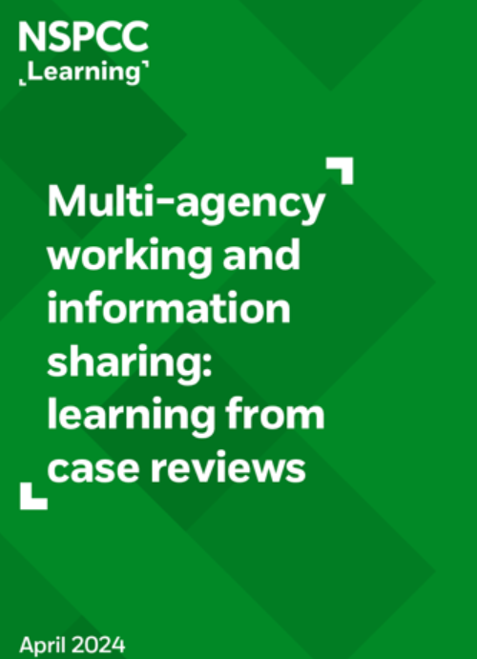
Supporting International Students
Background
A recent CSPR completed, has identified the potential vulnerabilities our International Students in independent schools may have. These may require additional support planning and intervention from a range of agencies, taking a systemwide approach to meeting the child or young person’s individual needs. It must be acknowledged, children and young people moving into the country, may have additional vulnerabilities, previous intervention in their country of origin and cultural needs that must be met by those working with them.
Time to reflect…
What reasonable adjustments do you offer within your practice?
When caring for an International Student, are you assured you have received all required information from previous teams to support your holistic assessment and care/treatment/education plan?
Are you professionally curious in your practice?
In your practice, who are you likely to share information with?
How confident are you to share information in relation to a child or young person who is an international student?
How confident are you to have a conversation with the family who may reside in another country? How would you arrange this?
How could you enhance information sharing in your practice?
Do your records clearly capture the review of records and decisions around the child/young person’s care and needs?
Are there barriers in your practice to fully support international students? If so, how do you overcome these?
How do you ensure your have “closed the loop” and obtain feedback when required?
How can we support our International Students?
Be culturally sensitive; this may require reasonable adjustments being made ie: translation services, additional appointment times and offer an open culture that values diversity and inclusion.
Provide a sense of belonging, support integration and inclusivity
Upon GP registration (within 10 working days), ensure information and appropriate documents have been sought by the education provision/other agencies/providers in terms of needs identified by the parents/carers, child or professionals.
If additional needs are identified, arrange a face-to-face appointment
Code in the child/young person’s records accordingly using SNOMED “international student” along with stating additional needs and/or safeguarding concerns.
Review documents received and follow up any outstanding (ensuring they form part of the medical record), document parental responsibility and ensure any required referral to specialist care is completed
Medication prescribing and dispensing. Any young person moving into the UK requiring medication previously prescribed out of country, must be reviewed and prescribed by the registered GP. The GP and Pharmacist should follow local protocol or formulary and seek review from specialist services ie: CAMHS, Community Paediatrician, Secondary Care and GP if required.
If safeguarding concerns are suspected or identified, a referral should be made to the local MASH team and concerns documented in records. Always consider Early Help if additional support is required.
Parents must appoint an Education Guardian for the child/young person who will act as a local point of contact and support for the child
Where concerns exist regarding the health and wellbeing of the child/young person, if they move within the UK for temporary or longer-term residence; children’s social care, the GP practice and school should work together ensure an appropriate handover to the local teams responsible, including the appropriate staff at the child/young person’s residence.
Key Documents & links
Best Practice Guidance for Supporting Health & Wellbeing of Children & Young People moving into UK from abroad for Education
Department for Education (DfE) (2023) Improving multi-agency information sharing (PDF). [London]: Department for Education
Department for Education (DfE) (2024) Information Sharing: Advice for practitioners providing safeguarding services for children, young people, parents and carers. [London]: Department for Education
Association for the Education & Guardianship OF International Students https://aegisuk.net/

Slide 38
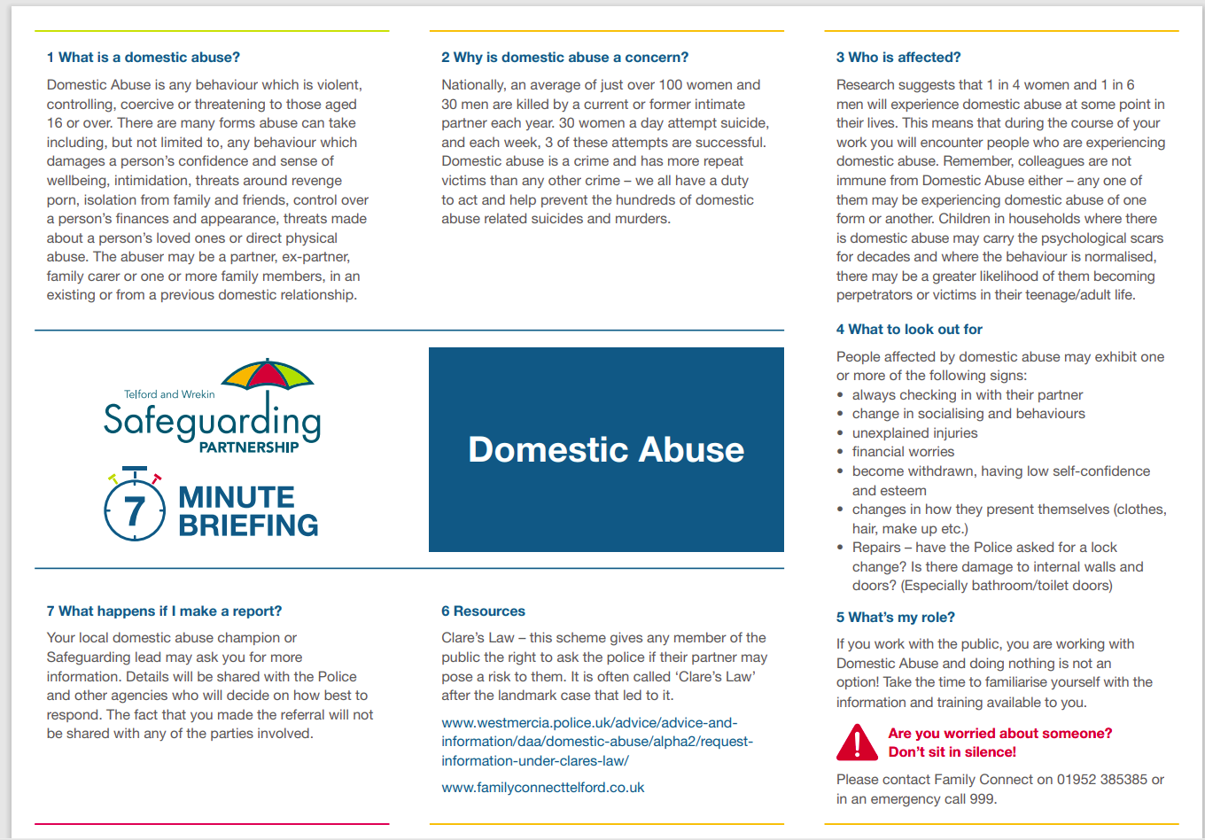

Slide 39
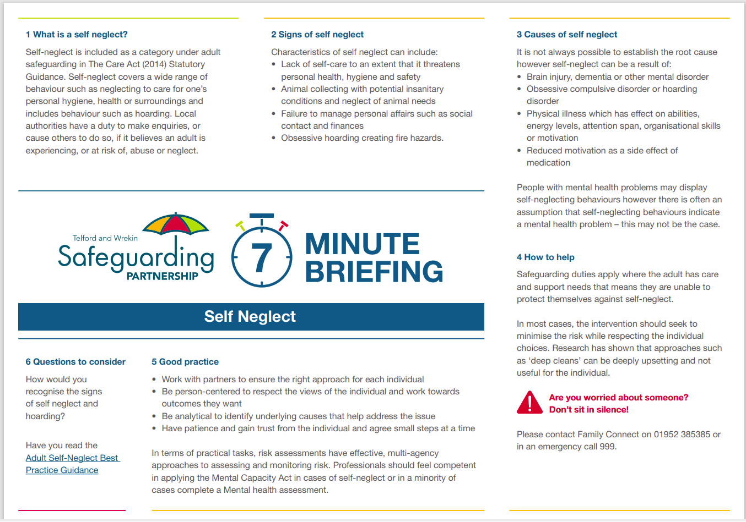

Slide 40
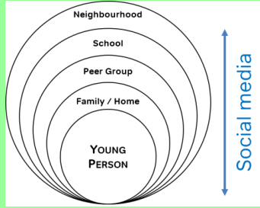
Contextual Safeguarding
1. What is it?
Contextual safeguarding seeks to identify and respond to harm and abuse posed to young people outside of their home, either from adults or other young people.
2. Why does it matter?
Traditional approaches to protecting children and young people from harm have focussed on the risk of violence and abuse from inside the home, and do not always address the time that children and young people spend outside the home. As children move from childhood into adolescence they spend increasing amounts of time socialising independently of their families. Contextual safeguarding recognises that the different relationships that young people form in their neighbourhoods, schools and online can feature violence and abuse. Parents and carers have little influence over these contexts and young people’s experiences of extra-familial abuse can undermine parent-child relationships.
3. Expanding the capacity to safeguard:
website.
6. Push Factors – some reasons that could lead to a young person becoming distant from the people who would usually protect them:
• Living with domestic abuse
• Being thrown out of home
• Family behaviours and beliefs
• Being in a residential or foster placement where they are unhappy
• Alcohol or substance misuse within the home
• Parents with mental health problems
• Having problems at, or not being in school, training or employment
• Being bullied or threatened
• Having siblings with difficulties
• Being in trouble
• Bereavement or significant loss
4. An approach, not a model:
We need to recognise that children and young people are vulnerable to abuse beyond their front doors and via the internet/social media
Target the context in which the abuse occurs, from assessment through to intervention.
Frame work to address extra-familial risk through the lens of child welfare and not crime reduction or community safety
Utilise the partnerships between agencies that reach into extra-familial contexts (transport providers, schools, retailers, resident associations, parks & recreational services etc.)
Measure success with reference to the nature of the context in which the harm has been occurring, rather than focussing on any behaviour changes displayed by young people who were at risk of these contexts
website.
5. Pull Factors - The grooming techniques used to gain the young person’s attention, admiration, and affection often that often tap into their insecurities or desire for acceptance and status:
• Receiving alcohol, drugs, money, or gifts
• Getting a buzz and the excitement of doing something risky or forbidden
• Feeling accepted
• Being offered somewhere to stay where there are no rules
• Being given lifts, taken to new places and having adventures with a casual acquaintance
• Being part of an alternative scene
• Meeting somebody who thinks they are special on the internet/social media
.

Slide 41
Online Safety
What is online safety?
Simply put, online safety refers to the act of staying safe online. Commonly known as internet safety, e-safety and cyber safety. It encompasses all technological devices which have access to the internet from PCs and laptops to smartphones and tablets.
2. Who can it affect?
Online safety is paramount in the world we live in, it can affect absolutely everyone from you personally to multinational companies. Ikea, Post Office and the NHS have all been affected . Lack of knowledge can make you especially vulnerable. There are ways which you can protect yourself by becoming aware of how you may be affected. ‘STOP-THINK-FRAUD’
3. Why is online safety important?
There are different ways that you could be affected. Financial scams, fraudulent websites, online scams via Social media platforms such as Instagram, Text messages, phone calls, Courier fraud and even QR codes. Fraudsters use a range of ways to try and get your personal details for identify theft or financial gain. Companies can be targeted using Ransomware, enabling them to access data held by these companies. Phishing/smishing emails and texts target consumers pretending to be from a well-known source. Opening these confirm the number or email is live and make you vulnerable to further attacks. Quishing is when QR codes are stuck over legitimate ones for example parking charges.
7. Help available.
Action Fraud – report fraud and cybercrime. www.actionfraud.police.uk or call - 0300 123 2040
Phishing emails report to – report@phishing.gov.uk
Text (Smishing) fraud – text to 7726
Report a Fraudulent website – ncsc.gov.uk/report-scam-website
Financial conduct Authority - https://www.fca.org.uk/
4. What you can do.
DO: Choose Strong Passwords. Password managers can help. Do not use identifiable information such as dates of birth, children's names etc. Don’t use the same password. Three random words, make them complex add characters for letters for numbers.
DON'T share your password.
DO: Enable Two-Factor Authentication. Makes it more secure if using different devices.
DO: Keep your devices and apps up-to-date, for up-to-date software and security
DON'T stick with a Single Email Account. Create a separate email account for important things such as banking.
DON'T store Personal Card Details on Websites.
6. What to do if concerned.
Happening now call 999.
Further information is available online to support you. The Little Guide to... preventing fraud and cyber crime | Metropolitan Police
You can request a check to see if your data has been part of a breach. Here. This will prompt you to change passwords on relevant sites.
Check if a financial firm is authorised Here.
The key message is ‘If it looks too good to be true it probably is’
5. Consequences.
Fraudsters can obtain personal details, bank account details, potential passwords for other sites, safeguarding information and most of all money. The amount of money lost to fraud in a single month during 2024 in our local area is £1.5 million, nationally this figure rises to £105 million. Scammers are very good at finding vulnerabilities particularly around love and belonging. Repeat victims often are aware they are being scammed they will continue contact and sending money, as they feel it's their only form of human contact.
website.
.

Slide 42

Trauma Informed Practice
The young people’s voice along with that of parents and carers through Telford and Wrekin Consultation
Question: “How should we work alongside trauma?”
“Be trauma attuned” “understand the impact trauma has and the layered impact”
“how is it understood in the context of the person and the family”,
“see beyond the layers and how trauma can impact on relationships within the family, with practitioners and how we foster growth and recovery”.
the context of the person and the family, see beyond the layers and how trauma can impact on relationships within the family and with practitioners and how we foster growth and recovery.
“Trauma is an invisible force that shapes our lives. It is the way we live, the way we love and the way we make sense of the world. It is the root of our deepest wounds”
“Trauma is not what happened to you, but what happens inside you as a result of what happened to you”
Dr Gabor Mate
Young people tell us they want adults Supporting them to:
Know that everyone’s experience is different, and it doesn’t define who I am
Recognise all of my needs and see me as a whole person
Understand my behaviour – when I’m shouting, crying, hiding, stealing, hitting out at myself or others, I’m just trying to make sense of everything I’ve gone through
Find a way to communicate that works for me
Include me in decisions about my life – ask me what I want to happen
Build on my strength and help me find new ways to recover
Trauma and Mental Health | Guide For Parents | YoungMinds
Accessing support for children and young people, parents & carers and professionals working with families:
Speak to school
Speak to the General Practitioner
Emotional support services
BeeU :: Midlands Partnership University NHS Foundation Trust (mpft.nhs.uk)
Trauma-informed practice is an approach to health and care interventions which is grounded in the understanding that trauma exposure can impact an individual’s neurological, biological, psychological and social development” (Office for Health Improvement & Disparities, 2022)
Trauma results from an event, series of events or set of circumstances that is experienced by an individual as harmful or life threatening which can cause lasting adverse effects. As a professional, we must consider the 6 key principles of trauma-informed practice:
Safety – ensuring the physical, psychological, and emotional safety is prioritised
Trust –transparency existing among staff, children and young people, wider community and organisational policy and procedures
Choice – supporting children and young people in shared decision making, choices and goal setting
Collaboration – recognising the value of children/young people and professionals working with families in overcoming challenges and improving systems
Empowerment – giving children, young people and professionals working with families a voice in decision making
Cultural consideration – moving past cultural stereotypes and biases based on individual beliefs, cultures, and characteristics.

Slide 43
Professional Curiosity
What is professional curiosity?
“Professional Curiosity is a combination if looking, listening, asking direct questions, and reflecting on information received”. (Quote: Worcestershire Childrens Safeguarding Board). It is a golden thread through all Safeguarding Partnership learning reviews and audits and is an essential part of safeguarding. Nurturing professional curiosity is a fundamental aspect of working together to keep children, young people and adults safe. A lack of professional curiosity can lead to missed opportunities to identify less obvious indicators of vulnerability/significant harm.
2. Why it matters?
Incorrect assumptions can be made in assessments of needs and risk which could lead to wrong interventions for individuals and families. It is natural to want to believe the best of a family, thinking the unthinkable does not mean assuming the worst. It means keeping an open mind, thinking objectively about the evidence presented. Professional curiosity involves using more than one source of information, using appropriate language, tools, and settings. Information sharing comes up as an issue in 98% of statutory case reviews!
3. Use your senses!
Look: Is there anything about what you see when you meet with this adult/ family which prompts questions/makes you feel uneasy?
Looking beyond prejudice
Are you observing any behaviour which is indicative of abuse or neglect?
Does what you see support or contradict what you’re being told?
Listen: Are you being told anything which needs further clarification?
Are you concerned about what you hear family members say to each other?
Is someone in this family trying to tell you something but is finding it difficult to express themselves?
Top tips
Be watchful for disguised compliance
Using motivation interviewing techniques
Appreciate the impact of lived experiences on someone’s ability to be open and honest
Think outside of the box
Actively listen
Use all of your senses (sight/hearing/smell/touch)
Think the unthinkable
4. What to ask
Ask: Are there direct questions you could ask when you meet this adult/family which will provide more information about the vulnerability of individual family members. Here are some examples:
How do you spend a typical day? Who do you live with? When were you last happy? What do you look forward to? How did you get that injury? Who is this with you? When do you feel safe?
Check out: Are other professionals involved? Have other professionals seen the same as you? Are professionals being told the same or different things? Are others concerned? If so, what action has been taken and by whom?
6. Be self aware in your practice
Professionals need to have a degree of caution in their judgements and triangulate information. This means seeking independent confirmation of individuals’ accounts and weighing up details from a range of sources or practitioners, particularly when there appear to be discrepancies. Professionals need to be aware of their own values without letting them influence their decision making and practice in a way that is non-judgemental and anti-discriminatory. People can be convincing and it’s really easy to take them at face value.
website.
5. Think family
A Think Family approach to safeguarding work with children and adults and their families is essential. When completing assessments we need to take opportunities to see, feel and recognise risk and enquire deeper. Being open minded and curious will help to make an informed decision about the child’s, adult’s or families’ lived experiences. Analyse all available information and record all concerns and considerations.

Slide 44
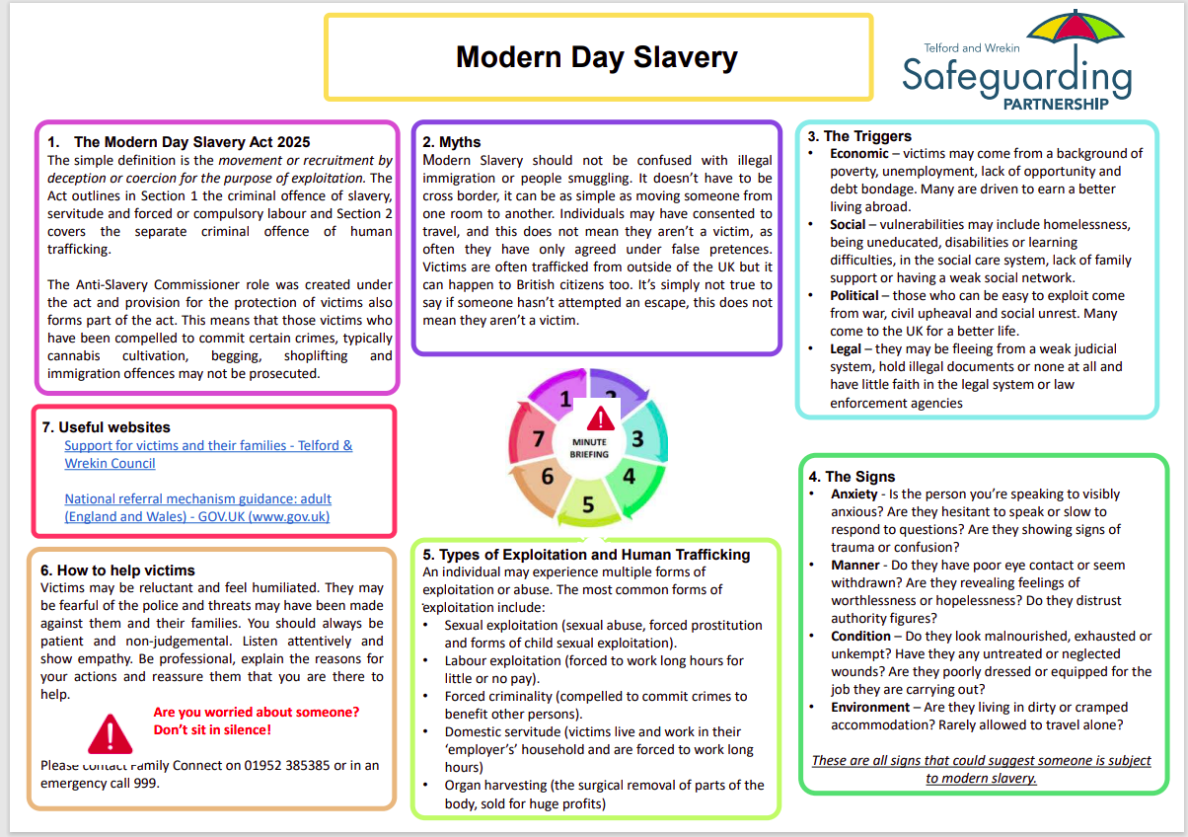

Slide 45
Learning Briefing
Care Planning Meetings
Purpose of a care planning meeting
Care Planning Meetings are held for children who are subject to local authority care. The purpose of a care planning meeting is to bring together professionals and significant people involved in the child’s life to enable a collective supported response to meeting their needs in the best interest of the child/young person and promoting wellbeing. It provides an opportunity to make any changes to their care and support plan and agree clear actions and next steps incorporating any new risks identified and/or assessments completed. It is imperative to champion the strengths of the child/young person.
2. Frequency of care planning meetings
Care planning meetings take place as a minimum of every 4-6 weeks in line with the child’s present circumstances however a care planning meeting should be arranged if there is anything of significance that has occurred in the child’s life. Examples of this may include; missing episodes, instability of their caring arrangements ie: change of residence, identification or escalation of risk, change in the child/young person’s needs and little progress or drift on agreed actions.
3. Membership of care planning meetings
Membership should include all relevant professionals and significant people involved in the child/young person’s life. This includes but is not limited to:
Children’s Social Care and/or identified lead practitioner
Specialist services (including CATE practitioners)
Education provision (including alternative provision/virtual schools)
Health professionals (including 0-19 service practitioner, mental health practitioners, private health providers ie: therapists)
Birth parents
Caregivers (including residential managers)
Child/young person (if appropriate) or their advocate
If there are concerns in relation to attendance, this should be raised with the appropriate management teams by the lead professional.
The Independent Review Officer should be advised of the outcome and receive a copy of the minutes.
7. Escalation
All attendees have the responsibility to escalate any cause for concerns in relation to attendance, progression of actions, professional drift, disguised compliance and/or additional safeguarding risks.
There must be clear lines of reporting for those attending the meeting should disputes be raised and where required using the Escalation Policy.
Please note, anyone (including family members) can request a care planning meeting.
website.
4. Roles and Responsibilities
It is the responsibility of all in attendance to contribute towards the discussion, share information, risk assessment and agree and formulate the child/young person’s plan. Discussions and actions must include detail of the lived experience, voice of the child and impact on the child. Actions should be progressed with achievable timescales and must be reviewed with updates and evidence provided to the members at the following meeting. Information shared is to include any privately commissioned assessments or work undertaken that inform the care planning of the child/young person. Any safety plans must be shared to inform the overall assessment and identified actions.
Accurate minutes must be a true reflection of the meeting that took place and any discrepancies to be raised with the minute taker for amendments where required.
There must be consideration for information to be written to the child/young person where appropriate.
If there are professional disputes, the partnership escalation policy must be followed.
5. Next Steps
A robust action plan must be agreed with clear timeframes set and accountable leads identified in the best interest of the child/interest; promoting their health and wellbeing.
The plan should be clear around the impact on the child/young person’s lived experience, capturing their voice and views.
The care plan must be a true reflection of their current circumstances and support in place.
Actions must ensure relationships when in the best interest of the child/young person, are promoted.
Any gaps identified must be addressed with a clear action.
6. Importance of information sharing
Information sharing is imperative in all safeguarding practice. Members attending the meeting hold the responsibility to share information back to their own agencies to inform further care planning in addition to bringing the required information to the meeting. Information shared should be proportionate and balanced.
Risk management and safety plans including updated plans must be shared within the meeting attendees following the meeting alongside the minutes. These should be shared within 10 working days.
.

Slide 46
Multi-agency working and information sharing
Background
Multi-agency working and information sharing are key to effective safeguarding and child protection (DfE, 2023). Information sharing is essential for identifying patterns of behaviour, or circumstances in a child’s life that may be evidence that they are at risk of harm or being harmed and need some form of support or protection. As stipulated in DfE (2024), data protection legislation (Data Protection Act, 2018) and the UK General Data Protection Regulation (GDPR) does not prevent the sharing of information for the purpose of safeguarding children, when it is necessary, proportionate and justified to do so.
Time to reflect…
In your practice, who are you likely to share information with?
How confident are you to share information in relation to a child or young person?
How confident are you to have a conversation with the family to advise them you are sharing information (if deemed safe to do so)?
How could you enhance information sharing in your practice?
Do your records clearly capture decisions around information sharing?
Are there barriers in your practice to share information? If so, how do you overcome these?
How do you ensure your have “closed the loop” and obtain feedback when required?
Do you know who to contact within your organisation if you were unsure whether to share information?
Are you aware of the benefits of sharing information to safeguard children and young people?
7 Golden Rules (DfE, 2024)
All children have a right to be protected from abuse and neglect. Protecting a child from such harm takes priority over protecting their privacy, or the privacy rights of the person(s) failing to protect them.
When you have a safeguarding concern, wherever it is practicable and safe to do so, engage with the child2and/or their carer(s), and explain who you intend to share information with, what information you will be sharing and why.
You do not need consent to share personal information about a child and/or members of their family if a child is at risk or there is a perceived risk of harm.
Seek advice promptly whenever you are uncertain or do not fully understand how the legal framework supports information sharing in a particular case.
When sharing information, ensure you and the person or agency/organisation that receives the information take steps to protect the identities of any individuals (e.g., the child, a carer, a neighbour, or a colleague) who might suffer harm if their details became known to an abuser or one of their associates.
Only share relevant and accurate information with individuals or agencies/organisations that have a role in safeguarding the child and/or providing their family with support, and only share the information they need to support the provision of their services.
Record the reasons for your information sharing decision, irrespective of whether or not you decide to share information.
Key Documents
Department for Education (DfE) (2023) Improving multi-agency information sharing (PDF). [London]: Department for Education
DfE non statutory information sharing advice for practitioners providing safeguarding services for children, young people,parents and carers
Department for Education (DfE) (2024) Information Sharing: Advice for practitioners providing safeguarding services for children, young people, parents and carers. [London]: Department for Education
Child Safeguarding Practice Review Panel (2024) Annual report 2022/23: patterns in practice, key messages and 2023/24 work programme (PDF). [London]: Child Safeguarding Practice Review Panel

Slide 47

Learning from CSPRs / Rapid Reviews
CSPR 9
CSPR 10
CSPR 14 & 15 (Neglect thematic review)
CSPR 17
CSPR 18
CSPR 25

Slide 48
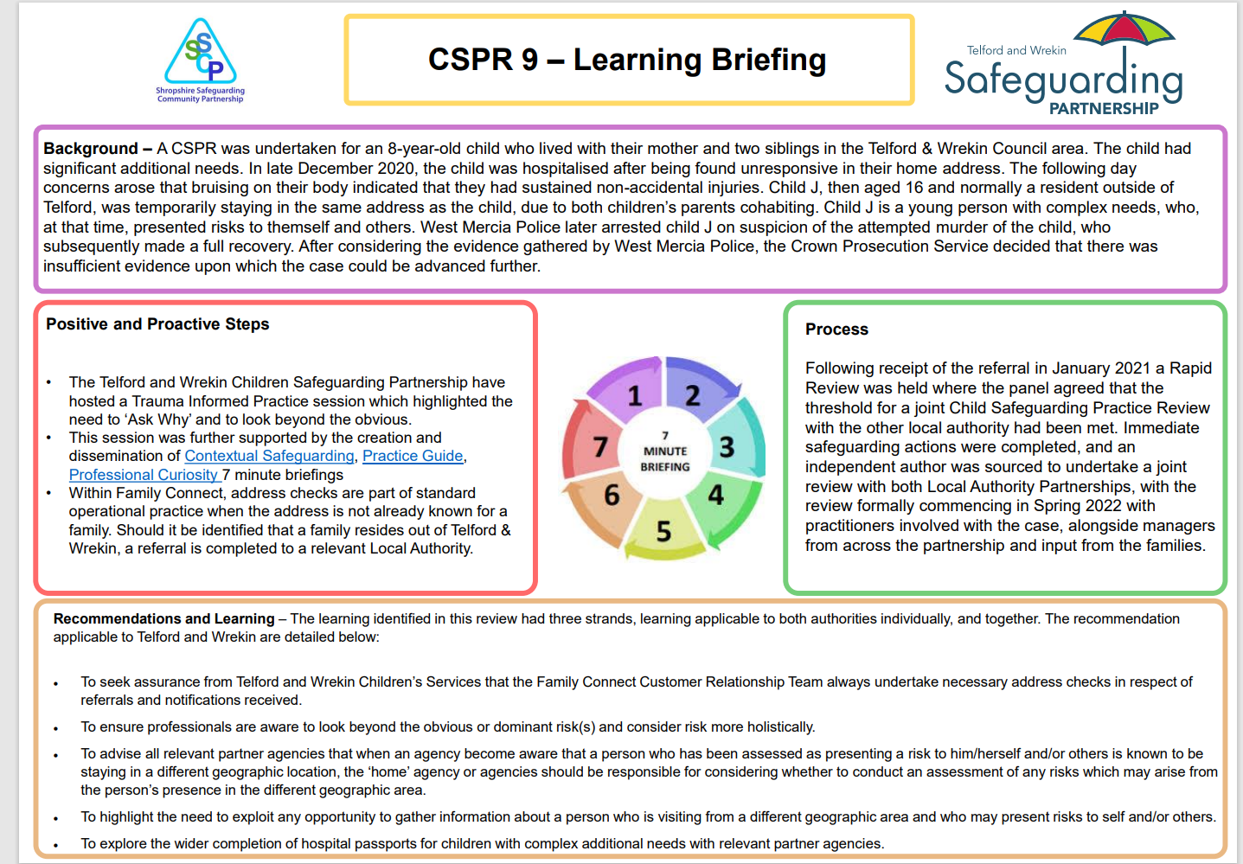

Slide 49
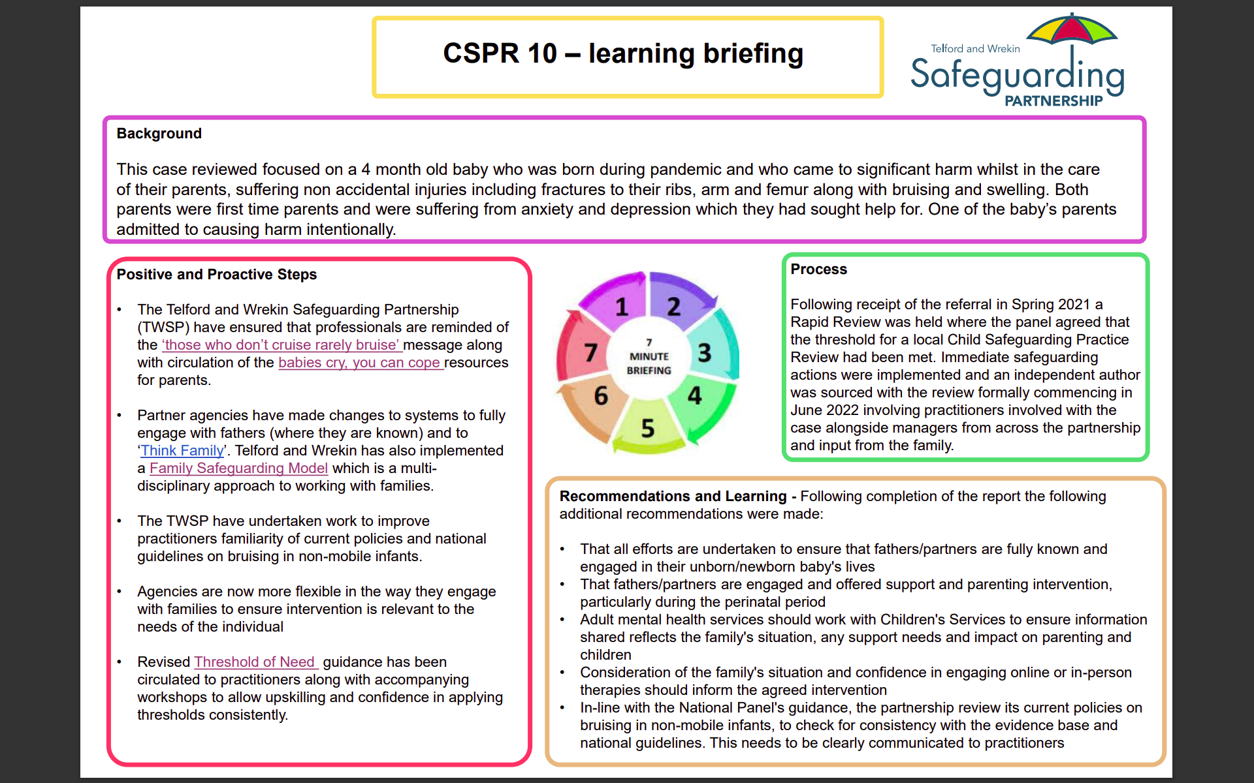

Slide 50
CSPR 14 and 15 – learning briefing
Case Background
CSPR 14 involved the death of a four-week-old baby. There do not appear to be any suspicious circumstances regarding this child’s death. Following the death, significant concerns were identified about the living conditions of the baby and their siblings, who were living in the family home with their mother as their sole carer. CSPR 15 also involved concerns about home conditions. The family consisted of three children, one at primary school and two at secondary school. They lived with their mother and had regular contact with their father.
Positive and Proactive Steps
Learning has taken place with all designated Safeguarding Leads in schools to consider ways to ensure they understand a child and their family’s history in the context of their decision making around safeguarding concerns.
The partnership actively encourages a ‘think family’ approach to ensure that professionals consider the wider family circumstances and background throughout any reviews, assessments or support. The Telford and Wrekin Family Safeguarding Model ensures that professionals are brought together to support parents to make positive changes. Encouraging professionals to be professionally curious is a regular theme within the various training session and training material.
The Partnership has commissioned an independent reviewer to explore how we approach the issue of neglect. They are exploring how we work with families from the point of referral all the way through to Child Protection conferences. Engagement has already taken place across all partners at all levels to ensure . There has been key participation from families with lived experience which has allowed a crucial insight into how the words used by professionals and changes to documents would have aided the safeguarding process from their perspective. The new strategy is due to be in place by Spring 2024
Process
Following receipt of the referral relating to CSPR 14 in November 2022 a Rapid Review was held where the panel agreed that the threshold for a full Child Safeguarding Practice Review had been met. Shortly after this decision was made, a further referral was received in February 2023 relating to CSPR 15. Immediate safeguarding actions were implemented and an independent author was sourced to undertake a thematic review into neglect which commenced in April 2023 involving practitioners involved with the cases alongside managers from across the partnership and input from the families.
Recommendations and Learning – Following completion of the review in the following recommendation were made:
The Partnerships recognises the need for, and implements, a neglect strategy and toolkit to improve the understanding of neglect
barriers to engagement are explored to ensure that these are addressed across all partner agencies.
Learning is shared regionally and requests are made that multiagency guidance on the management of concealed pregnancy be developed implemented.
The Partnership seeks assurance that all schools are aware of the need and importance to access information about a child’s history when they have any concerns
Professionals are aware of the expectation to include all background information/concerns when making a referral

Slide 51
CSPR 17 – learning briefing
Background:
This case review focussed on the death of a young person following suicide. In the months before her death she had disclosed that she had been a victim of abuse which was being investigated by police. She had suffered with a history of self harm and overdoses which had led to hospitalisation. She had also been electively home educated prior to her starting secondary school during the Covid pandemic. A social work assessment had been undertaken and support to help her manage her feelings was offered which was subsequently reviewed as risks increased but support levels did not increase.
Positive and Proactive Steps Already Taken:
The Telford and Wrekin Safeguarding Partnership (TWSP) will shortly been announcing the date of a partnership wide Trauma Informed Practice training session
All practitioners have been reminded of the need to always remain professionally curious with the circulation of a 7 minute briefing
The Escalation Policy has been reviewed and recirculated to all practitioners
Remaining actions will be completed by the end of the year
Process:
Following receipt of the referral in Spring 2022 a Rapid Review was held where the panel agreed that the threshold for a local Child Safeguarding Practice Review had been met. Immediate safeguarding actions were implemented and an independent author was sourced with the review formally commencing in June 2022 involving practitioners involved with the case alongside managers from across the partnership and input from the family.
Recommendations and Learning: Following completion of the report the following additional recommendations were made:
reinforce the importance of all assessments being informed by a child’s trauma and the importance of considering the parents’ capacity to meet the child’s needs is fully explored
reinforce the need for professional curiosity and looking for reasons behind behaviours
review arrangements for undertaking early help assessments and plans to ensure that when children have emerging needs, a co-ordinated early help response is offered and led by a Lead Professional.
review escalation policy to ensure staff members understand the importance of escalating concerns about a partner agency to resolve the issue for the child and their family.
seek assurance that the arrangements for monitoring home education take into account the child’s holistic safeguarding and welfare needs
seek assurance that the arrangements for investigating allegations of familial abuse outside of daytime services working hours are conducted in accordance with statutory guidance

Slide 52
CSPR 18 – learning briefing
Background
This case review considered a family of four children. The family were previously known to partner agencies in both Telford and Wrekin and another Local Authority due to child safeguarding concerns. The older children had been the subject of child protection planning and spent time in care due to significant neglect, largely due to parental drug misuse, mental health, and criminality. They had lived with their grandparents for eight years before returning to mum in 2018. A third child had been born in 2017 to mother and her partner and was initially on a child protection plan and then a child in need plan in Telford and Wrekin before the family moving away in 2018. Child 4 was born in April 2021 and sadly died a year later.
Process
Following receipt of the referral in Spring 2022 a Rapid Review was held where the panel agreed that the threshold for a local Child Safeguarding Practice Review had been met. Immediate safeguarding actions were implemented and an independent author was sourced with the review formally commencing in September 2022 involving practitioners involved with the case alongside managers from across the partnership and input from the family.
Positive and Proactive Steps
The Telford and Wrekin Safeguarding Partnership (TWSP) have developed some practical guidance around being culturally aware.
All practitioners have need reminded of the need to remain professionally curious via the 7 minute briefing and regular references in other training in order to understand the dynamics in the family and identify young carers
Further awareness raising has taken place with wider partners, including Fire and Rescue to encourage them to highlight concerning home conditions they may see during routine visits with the local authority. The Home Conditions Procedure and assessment tool guides practitioners through various indicators and allows consistent scoring of risk to take place.
The Hoarding and Clutter Rating Assessment has also be circulated to practitioners
Recommendations and Learning - As a thematic CSPR (neglect) was completed just prior to this incident, it was agreed that this review would consider the potential impact of the learning and to agree any further recommendations that may be required which are highlighted below:
Remind professionals of the need to: * Be culturally aware and competent in assessments and direct practice. * Be sensitively honest about any difficulties in understanding a parent when English is not their first language. * Identify and support young carers. *Consider the needs and vulnerabilities of all members of the family. * Include unannounced visits in plans when working with a family where neglect and household conditions are a concern.
That the Partnership considers how it can ensure improved and good practice regarding safeguarding children who move across local authority borders, including those who are children in need.

Slide 53
Learning Briefing CSPR 25
Background:
This briefing is in connection to an international student, who was studying A-levels in England in 2023. Although initially described as shy and socially anxious, they gradually integrated, forming friendships and gaining confidence. Although the young person was articulate and was able to seek help when needed, it was documented that they often felt isolated and pressured to succeed. They experienced poor mental health, leading to anxiety and depression.
The young person died by suicide at the age 16 whilst attending a private summer residential programme at a university campus out of their primary education area. Their story reveals that being away from home and family can add to vulnerabilities such as mental illness and special educational needs. UK legislation emphasises family care for children, so that trusted adults can mitigate this vulnerability, as recognised in Keeping Children Safe in Education (2023). The education of international students is notable in schools and universities, with over 600,000 students coming to the UK annually. Therefore, the Review highlights significant gaps in regulation in safeguarding care for international students. Key themes, recommendations for safeguarding systems, and practice considerations for those working with international students in the UK is summarised below.
Themes 1: Reflection on Practice
Practice consideration A: That practitioners are reminded to be curious as to the everyday experience of students who are impacted by symptoms of as result of treatment and/or consider if the child's experience could be improved upon.
Practice consideration B: Practitioners should come together regularly to make sense of the lived experience of any students with additional needs.
Practice consideration C: That self-harming behaviour is never normalised or accepted by adults, but should be considered as a behaviour which suggests that a student is “dealing with very difficult feelings, painful memories or overwhelming situations and experiences.”
Theme 2: The response to an international student's, mental health
Practice consideration D: Due to potential culture differences regarding definitions of mental health and how diagnoses, symptoms, and possible labels are understood, there should be simple description of what information is requested and why it should be used.
System Recommendation 1 – For all boarding schools: where a student has a mental health diagnoses/treatment plan, the school should invite any mental health lead in the school and or clinical staff to attend alongside the school senior leadership team some or part of any admissions meetings with parents. The intended outcome is that the school can plan for any additional support the student might need, prior to the student arrival at school.
System Recommendation 2 – For all Integrated Care Boards (ICB): all children boarding with an independent school should be registered with a general practice local to the school premises. They should be assured that GP’s are clear regarding their role with international students. Any agreement between the GP and any independent day or boarding school in the locality should be supported by the local ICS/ICB in terms of quality and monitoring so that physical and mental health needs of this specific cohort are met.
System Recommendation 3 – For all Boarding Schools: Boarding Schools make prospective parents aware that students will be registered with the local GP. NB this may require a revision of the National Minimum Standard for Boarding Schools.
System Recommendation 4 - For all Boarding Schools: All students who arrive with known symptoms and a diagnosis of depression, mental health condition, or medical need, should be assessed and treated under the supervision of a UK-based clinician, with a regularly monitored treatment plan. The student’s health and wellbeing should be regularly reviewed by the multi-agency network of practitioners. Where consent is not given by the child a multi-agency meeting should be convened. The ISI and/or Ofsted should make their inspection of any school.
System Recommendation 5 – For all independent day and boarding schools employing school nurses. To ensure school nursing staff receive clinical and/or safeguarding supervision from a trained and accredited supervisor. This should be included in the ISI and/or Ofsted inspection frameworks.

Slide 54
Theme 3: Information Sharing and Seeking
System Recommendation 6 - For all boarding schools: That all adults involved in the care of an international student with additional needs are included in regular multi-disciplinary communications and meetings to reflect on the child’s progress.
System Recommendation 7 - For all independent day and boarding schools: It is recommended that all independent schools be reminded of the DfE non-statutory information-sharing advice (May 2024) and its relevance to safeguarding practice.
Practice consideration E: It is important that the due diligence by boarding schools of the implementation of NMS 22 [regarding education guardianships] includes the assessment of both the quality and the consistency of homestays.
Practice consideration F: Practitioners should reflect on when to share information, using the new guidance, to promote a student's welfare and protect them from safeguarding risks, especially when the risk outweighs the individual's unwillingness to engage.
Theme 4: Working across agencies to respond to risk
System Recommendation 8 - For all boarding schools: Multidisciplinary meetings should be held when a student with mental health needs joins the school including a range of staff from within the school, as well as external agencies and parents. A multidisciplinary risk assessment and safety plan should be drawn up with the student and parents and implemented. Such a meeting will be dependent on the complexity and severity of the student’s mental health needs.
Practice consideration G: Parents of international students can be helped, challenged, and supported to understand the options for their child’s education and well-being. Schools should take the lead so that teachers and staff can implement their duty of care for the child.
System consideration - For all boarding schools that sponsor international students: Schools should consider using all available means to safeguard children and make decisions that prioritise the child’s welfare with the right plan made for each student.
Theme 5: Safeguarding and the role of education guardians and homestay hosts in the lives of international students
System Recommendation 9 for the Department for Education and the Secretary of State for Education: To make the regulation of education guardianship statutory through national minimum standards for the sector.
System Recommendation 10 - For AEGIS all education agents and schools that advise parents to appoint education guardians: To establish as best practice that a student should meet their appointed education guardian as the trusted adult appointed to care for them at a (virtual) meeting before coming to the UK.
Practice consideration H: In the absence of statutory regulation, for AEGIS to continue to ensure best practice in ensuring that education guardians safeguard children.
System Recommendation 11 - For the Department for Education: The DfE establishes a clear and unambiguous legal position and revises statutory guidance regarding education guardianship and homestays so that education guardians and/or those providing a homestay are considered as in a position of trust.
Theme 6: The safety of out-of-education residential programmes
System Consideration for LSCPs: How to embed all this learning as relevant to all out-of-education residential programmes across the UK.
System Recommendation 12 for the Department for Education: Statutory regulations, supported by national minimum standards, are implemented across the out of education sector. To include as a minimum: Safeguarding policy; Application process, including multi-agency handover and transfer of information relating to additional needs; Admissions and registration; Risk assessment and management; Medication management, including storage and safe administration; Information management; Staff training and supervision; Supervision of students; Missing student responses; Provision of contact information for residents; All this information needs to be provided in languages and styles suitable for all students.
Addendum - Theme 1: CDOP Child Death Partners
System Considerations: The Child Death Review processes in both areas involved assimilating the learning from this review into their learning processes and annual reporting. Both LSCPs should lay out how this will be implemented. The LCSP to inform the coroner who conducted the inquest of this feedback from parents and participating agencies.

Slide 55
Learning from Domestic Homicide Reviews
DHR 2
DHR 3
DHR 4
DHR Jason

Slide 56
Learning from Safeguarding Adult Reviews
SAR Lou
SAR Patricia
SAR Violet

Slide 57
Safeguarding Adult Review – ‘Lou’
Learning Briefing
1. Background - This case review considered the death of a 40 year old person who resided within supported accommodation. They received full-time care due to having disabilities and underlying health conditions including severe epilepsy which was eased with the use of a Vagus Nerve Stimulation (VNS). Sadly, the person passed away suddenly in late 2022.
4. Positive and proactive steps taken to address the recommendations so far - In response to the initial recommendations, partner agencies within the Safeguarding Adults Review (SAR) Panel have taken meaningful and proactive steps to strengthen multi-agency collaboration and enhance safeguarding practice.
Strengthening Collaboration in Complex Cases: Partner agencies are actively working to improve joint planning for individuals with complex needs. There is a shared awareness of Section 42 safeguarding duties, including the importance of timely communication of investigation outcomes.
Enhancing Risk Assessment through Shared Knowledge: Updates to the social care risk assessment process are already underway, with a focus on clearly incorporating information from all relevant agencies. This ensures that risk assessments are comprehensive and person-centred.
Improving Care Plans and Quality Assurance: Reviews of safeguarding assessment and referral forms are progressing to ensure Care Plans accurately reflect individual needs. Quality assurance engagement with care providers is ongoing to uphold and continuously improve the standard of care delivered.
Collaborating on Assistive Technology Assurance: The Assistive Technology Team is partnering more closely with care providers to strengthen oversight and support around assistive technologies, helping ensure continuity of safe and effective care for those who depend on such equipment.
Raising Awareness Around Critical Incidents: A guidance note is being prepared and will be shared with care providers to clarify responsibilities following unexpected deaths and in situations involving police investigations. This will help ensure appropriate actions are taken with sensitivity and professionalism.
2. Process
Following receipt of the referral in Winter 2022 scoping information was requested which informed the decision to progress to a Safeguarding Adult Review (SAR) in Spring 2023. Immediate safeguarding actions were implemented and an independent author was sourced in early summer 2023. This review was run alongside a LeDeR review process which avoided duplication of work for agencies and reduced the impact on the family. The review panel was made up of practitioners involved with the case alongside managers from across the partnership and met formally four times throughout the process, with additional theme specific meetings taking place in between. Contact was maintained with the family throughout to update them on the progress and allow opportunity for them to contribute at their own pace.
website.
3. Recommendations and Learning
The following recommendations were made following the independent review:
Assurance should be sought around procedures reinforcing the need for a single multi agency plan to be developed in complex cases. If single agency reviews have taken place these should be shared with other agencies involved with the person. This should be audited regularly to ensure this is happening.
Assurance should be sought that the outcomes and recommendations from Section 42 enquiries are being shared at the earliest opportunity with all relevant organisations, including care providers.
Social Care should ensure that all guidance and templates address the issue of suitability of the care plan, taking into account identified risks such as fire or medical emergency.
The CQC and Social Care should use the findings of this review for future quality assurance of Home farm trusts provision Telford.
The assistive technology team should ensure clarity on roles and responsibilities of provision and maintenance of the equipment in cases where the care providers have their own technical support team, along with ensuring there is a contingency plan in place in case of equipment failure
Assurance should be sought that all care providers and community based professionals are aware of the ‘acid test’ in relation to DoL’s criteria and the process to follow for identified cases.
Telford and Wrekin Safeguarding Partnership should remind care providers and agencies not to initiate any investigation following a death where there is police involvement.
.

Slide 58
Safeguarding Adult Review – ‘Violet’
Learning Briefing
1. Background - This case review considered the death of Violet, a 75-year-old woman, in May 2024. She lived in a Wrekin Housing Group bungalow with her son, supported by her daughter and a care package delivered by an external agency (2 calls daily). Violet attended a day centre and enjoyed social activities. Her health conditions included reduced mobility, right-side weakness from strokes, and ulcerated legs. She used a wheelchair and required support for personal care. Violet died in hospital on 15 May 2024 following admission with sepsis and pneumonia.
4. Positive and proactive steps taken to address the recommendations so far - In response to the initial recommendations, partner agencies within the Safeguarding Adults Review (SAR) Panel have taken meaningful and proactive steps to strengthen multi-agency collaboration and enhance safeguarding practice.
Escalation Policies It has been recognised by Telford and Wrekin Safeguarding Partnership that there is a need for a review of the Escalation Policies. This has been completed and re-circulated. The Partnership has also recognised a training gap to deliver training on the use of the escalation policy to ensure this is accurately recorded.
Escalation Policy 2023-2025 - Telford and Wrekin Safeguarding Partnership
Multi Disciplinary Team Meetings: Awareness shared across the Partnership regarding the role of the MDT. Specific training and flow chart to be developed and rolled out by the Partnership.
2. Process
The SAR was commissioned following Violet’s death, meeting Care Act criteria. An independent author was appointed in December 2024. Evidence was provided by GP, Adult Social Care, Shrewsbury and Telford Hospital Trust, Shropshire Community Health Trust, West Midlands Ambulance Service, and Wrekin Housing Group. Combined chronologies and IMRs were collated.
A practitioner learning event in June 2025 allowed frontline staff to share insights into what went well, what could have been done differently, and how to improve practice.
The panel was made up of practitioners who knew the case alongside managers from across the partnership, the group met formally 4 times throughout the process.
The family have been updated and invited to be part of this review should they wish to do so.
website.
.
3. Recommendations and Learning
The following recommendations were made following the independent review:
Recommendation 1. All agencies to ensure staff have an increased awareness of the role of the MDT and ensure staff make relevant referrals that meet the safeguarding threshold.
Recommendation 2. All agencies involved to ensure all staff are aware of escalation policies in their own agencies and utilise appropriately and also be aware that local authorities have their own escalation processes, should practitioners not agree with a decision that has been made.

Slide 59
Safeguarding Adult Review – ‘Patricia’
Learning Briefing
1. Background - This briefing summarises the findings of the Safeguarding Adults Review into the case of Patricia, a 74-year-old woman who died in February 2024. The Review was commissioned because there was reasonable cause for concern about how agencies worked together to safeguard Patricia. Patricia’s report highlights complex challenges of health and care needs, self-neglect, family responsibility, immigration status, and system response.
4. Positive and proactive steps taken to address the recommendations so far - In response to the initial recommendations, partner agencies within the Safeguarding Adults Review (SAR) Panel have taken meaningful and proactive steps to strengthen multi-agency collaboration and enhance safeguarding practice.
Professional Curiosity: Telford and Wrekin Safeguarding Partnership have developed Professional Curiosity training and briefings across the partnership. Shropshire Community Health Trust have developed their own specific training rolled out across the trust.
Shropshire Community Health have improved record keeping and referral clarity and developed resources such as a ‘permission to pause’ video.
Professional curiosity 7 minute briefing developed: Professional curiosity - Telford and Wrekin Safeguarding Partnership
Multi Disciplinary Team Meetings: Awareness shared across the Partnership regarding the role of the MDT. Specific training and process flowchart to be developed and rolled out by the Partnership.
Easy access information on Self Neglect: Agencies are to review what is in place in regards to Self Neglect offer for practitioners and case sampling shall take plan to review impact. 7 minute briefing completed by the Partnership. Self Neglect - Telford and Wrekin Safeguarding Partnership
GP practice have introduced monthly searches for high-risk housebound patients and shared Patricia’s case in clinical meetings.
Home Office to review information available around ancestry visa: Contact has been made with the Home Office to share the learning and recommendations from this report.
2. Process
Following Patricia’s death in February 2024, the SAR was commissioned under Section 44 of the Care Act. An independent author was appointed in December 2024.
Agencies contributing evidence included: GP, Adult Social Care, Shrewsbury & Telford Hospitals Trust, Shropshire Community Health NHS Trust, Midlands Partnership NHS Trust, and West Midlands Ambulance Service.
Chronologies, Individual Management Reviews, and reports were collated. A practitioner learning event was held in June 2025 to explore what went well, what could have been done differently, and how to improve practice.
The review panel was made up of practitioners involved in the case alongside managers from across the Partnership and met formally four times throughout the time of the review.
Throughout this process the family have been kept up to date with progress and allow opportunity to contribute should they wish to do so.
website.
3. Recommendations and Learning
The following recommendations were made following the independent review:
Recommendation 1. All agencies to place a greater emphasis on professional curiosity. Need for partners to update training packages so that frontline staff place a greater emphasis about the value of exploring home circumstances/relationships further (Patricia was confined to her bed and unable to manage infected pressure sores and was generally not coping and her family were not able to manage this).
Recommendation 2. All agencies to ensure staff have an increased awareness of the role of the MDT and ensure staff make relevant referrals that meet the safeguarding threshold.
Recommendation 3. All agencies to ensure staff have easy access to information and assessment tools (such as self-neglect toolkit) this is vital as part of the ongoing support given to staff within all agencies working with adults at risk, to help them maintain their professional knowledge and understanding of complex safeguarding issues and where to go to get the help.
Recommendation 4. The Home Office to consider a review of information that is available to health and care professionals and families when applying for and being granted an ancestry visa. (The panel also recommended an easy read version).
.

Slide 60
Telford and Wrekin Safeguarding Partnership Toolkits and Best Practice Guidance
These toolkits/guidance have been developed by the Partnership, they aim to:
Standardise Practice: They set out agreed processes and expectations for all partner agencies.
Support Decision-Making: Offer step-by-step guidance for handling complex or contentious cases.
Promote Collaboration: Encourage timely communication and joint problem-solving between agencies.
Ensure Accountability: Define roles, responsibilities, and escalation routes to avoid drift or unresolved concerns.

Slide 61



Professional Curiosity Toolkit
The Professional Curiosity Toolkit is designed to help practitioners across agencies adopt a proactive, questioning approach when working with children, families, and vulnerable adults.
Purpose: Encourages practitioners to question, explore, and verify information rather than accept things at face value.
Key Focus: Helps identify hidden risks such as neglect, domestic abuse, or disguised compliance.
What It Provides:
Practical tips for asking deeper questions
.Reflective prompts (What am I being told? What might be missing?).
Guidance on overcoming barriers like assumptions or time pressures.
Outcome: Improves safeguarding by promoting critical thinking, respectful challenge, and timely escalation when concerns remain.
Access it here:
SAB Manager Network Professional Curiosity - Telford and Wrekin Safeguarding Partnership

Slide 62


Cultural Competence Guidance
Designed for practitioners involved in assessments, family plans, and care planning for adults, children, and families.
Aims to embed culturally competent practice across organisations, forming a basis for policy and service development.
Access it here:
Cultural Competence Guidance - Telford and Wrekin Safeguarding Partnership

Slide 63

Best Practice Guidance: Language in Practice
This guidance helps professionals in Telford & Wrekin use language that builds trust, reduces harm, and supports positive change for children, adults, and families. It draws on learning from safeguarding reviews and offers practical tips, principles, and alternative phrases to promote empathy, inclusion, and trauma-informed communication.
Access it here:
Best Practice Language Guide - Telford and Wrekin Safeguarding Partnership

