Slide 1
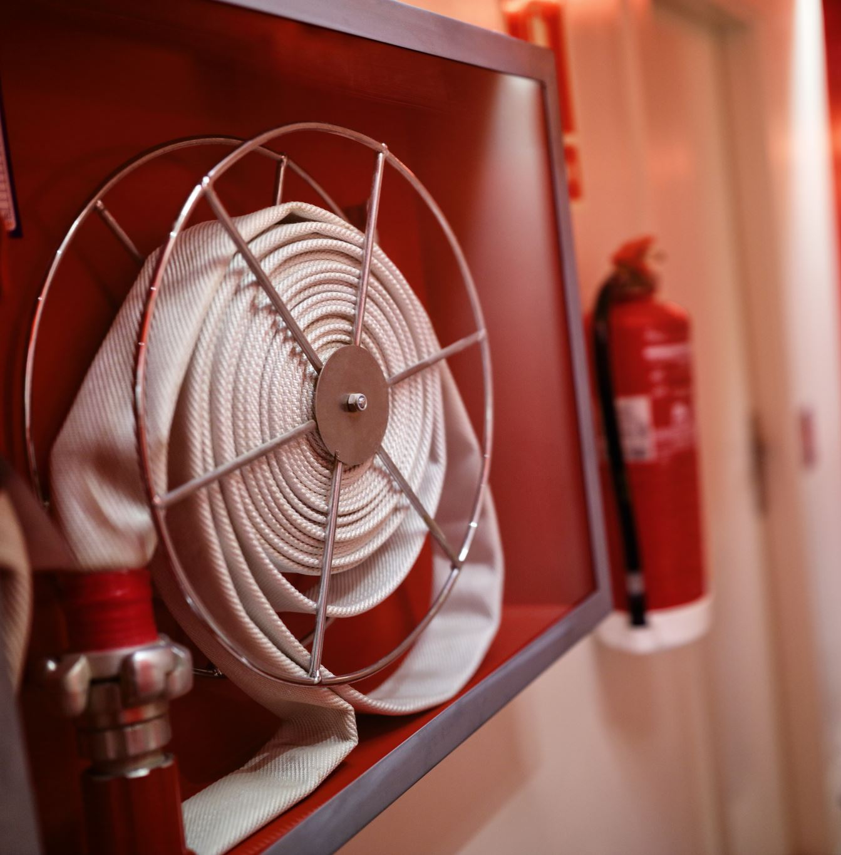

Adults at risk of harm due to fire
This webinar was hosted by Walsall Safeguarding Partnership as part of National Safeguarding Adults Week in November 2022 and shared learning from a recent Black Country Multi-Agency Audit that took place on adults with care and support needs with associated fire risk, this was undertaken across the four Black Country Safeguarding Partnerships (Walsall, Wolverhampton, Sandwell and Dudley). However, the report identified wider learning for the region. This was followed by a session from West Midlands Fire Service on how to identify, assess and promote the safety and wellbeing of their service users at risk of a fire, fire death or serious injury. The webinar addresses self-neglect as well as consideration of the mental capacity act etc.
Watch the seminar hosted by Telford and Wrekin Safeguarding Partnership below:
Webinar Identification and support for adults that are at risk of harm due to fire

